Slide 1
Prediction of games success
Data science final project
Alexi Barkan
Natan Gershbein

Slide 2

Research Question: Is it possible to predict the success of the game according to specific characteristics?
Is it possible to predict the success of the game according to specific characteristics
Message @Alzok

Slide 3
Project Stages
01|Data Acquisition
02|Data Handling
03|EDA
04|Machine Learning

Slide 4

Data acquisition
Data Sources:
https://www.metacritic.com/browse/games/score/metascore/all/
Summary:
One of the popular sites which combine Reviews and games ranking from users and critics (professional critics)
Our data acquiring method:
Crawling – BeautifulSoup
We collected various attributes which contains information about the games , for example : Platform ,Genres , Awards ,Meta Score , User Score etc..
After collecting the information,
we insert it to Data Frame “GamesDataFrame” – (19187 $×$ 32)

Slide 5
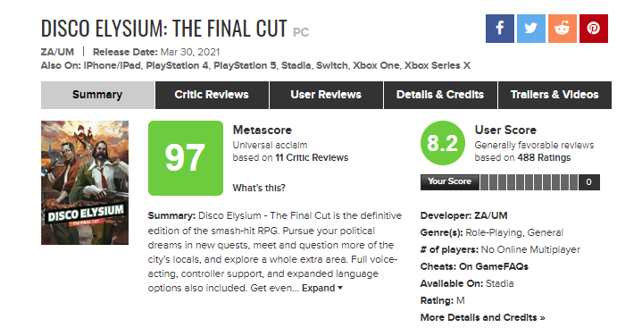
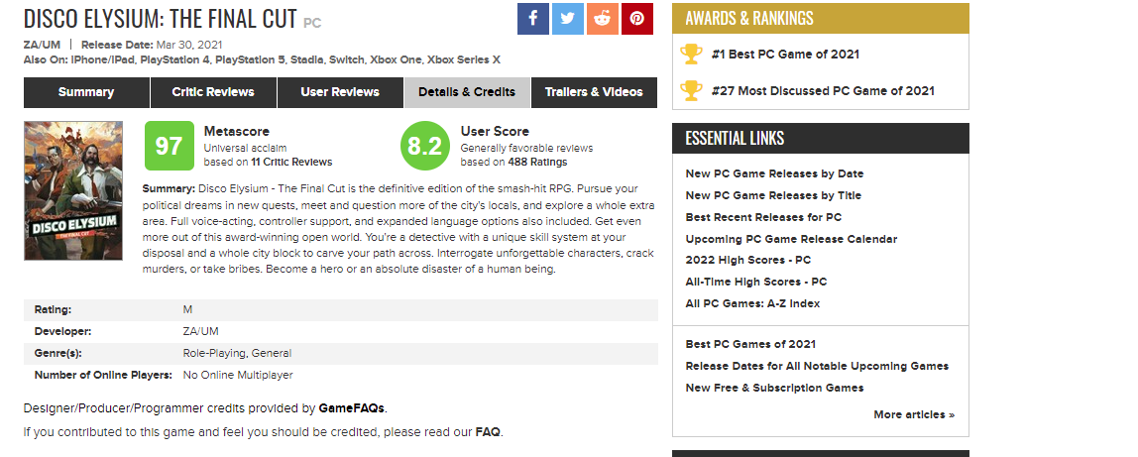
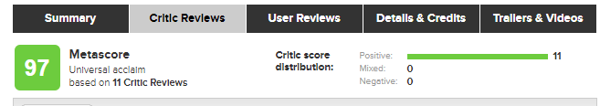
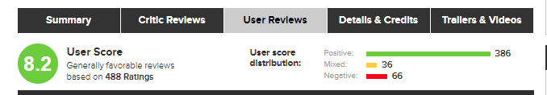
Crawling brief process
The Crawler runs on a list of 100 games per page , for each game it goes over several pages :
The Details & Credits page from which it takes attributes of the game such:
as Platform, Genres, Official Site, etc.
The Critic reviews page where- it takes the Metascore, the number of critics and the amount of each kind of reviews – positive negative and mixed positives.
User reviews page where it takes the User Score ,the number and quantity of votes - negative and mixed positive.
On the page of the game itself takes its list of awards and ratings.
And so on for 191 pages, each of which has 100 games.
We force the Crawler to sleep in between the Get requests because the site blocked us many times due to a lot of requests (very, very many times ) .

Slide 6
2|Data Handling

Slide 7
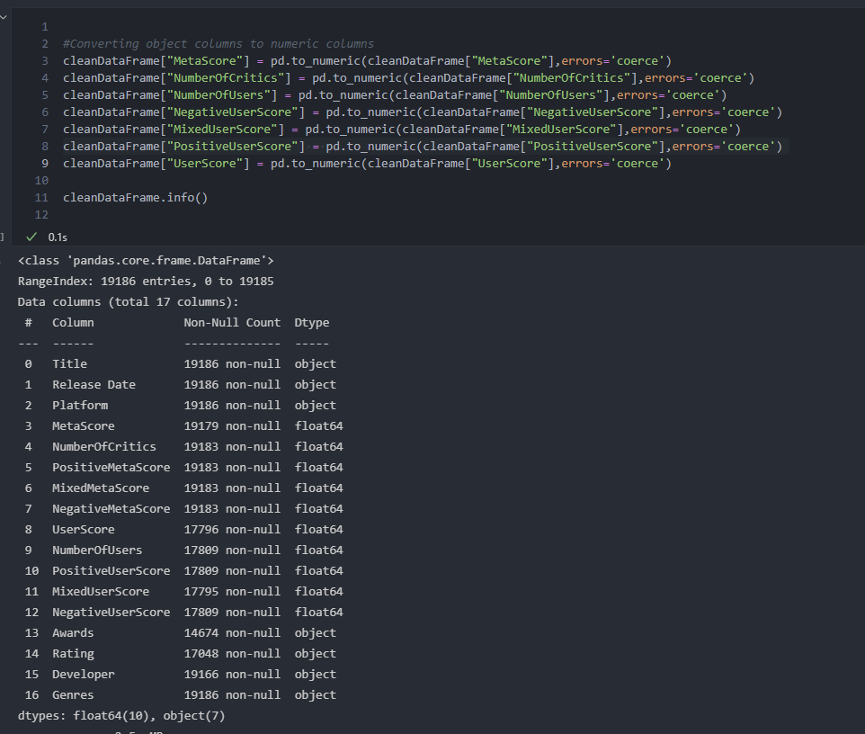
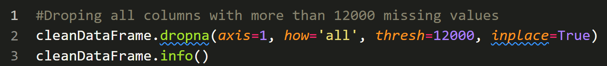
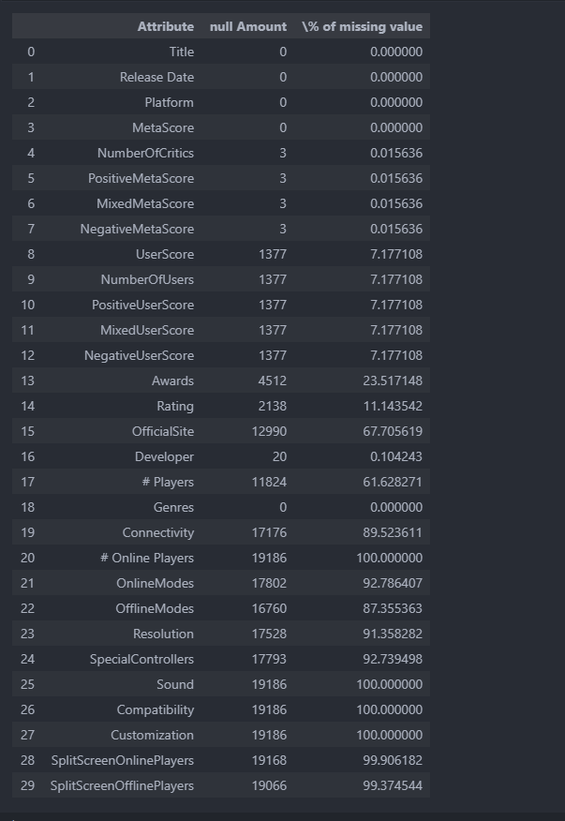
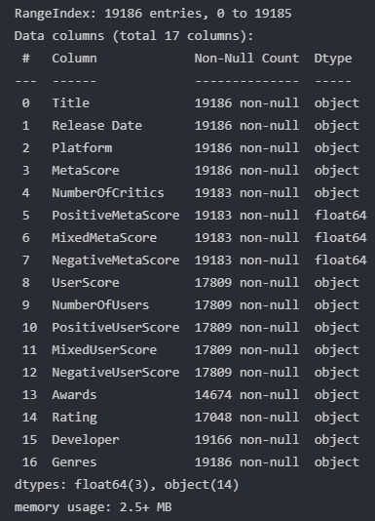
Cleaning Phase
The first observation of the data arises several points: Large number of missing values, Irrelevant columns wrong Format of some data like release date. 1. After an examination we found out that columns which have over then 12000 missing values are columns that we have no use for anyway and do not contribute to our analysis. As a conclusion , we decided drop them.
After the first cleaning we saw that most of the columns are objects Type – even the columns which suppose to be numeric. Hence, we convert them to proper type

Slide 8
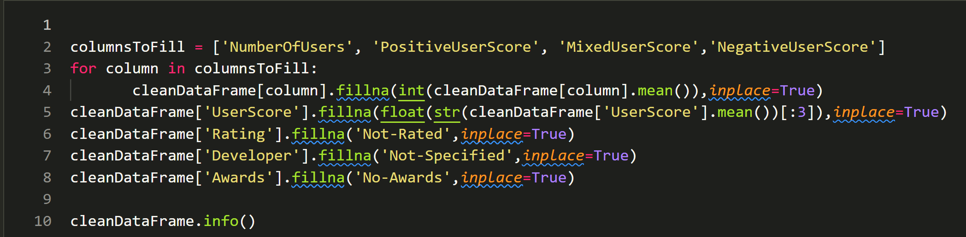
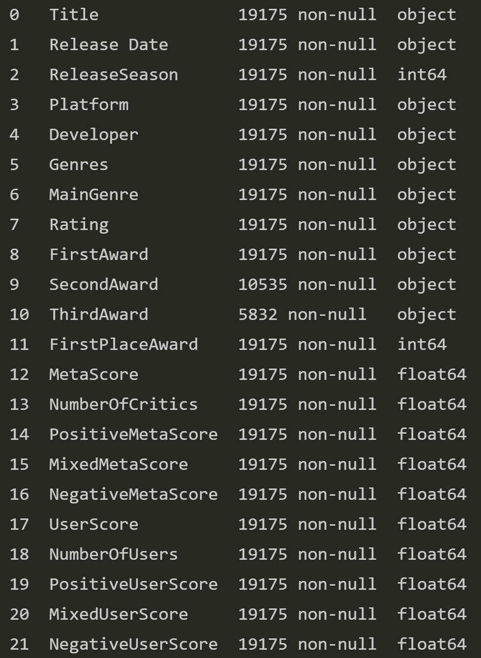
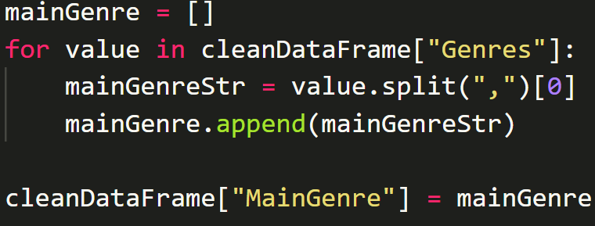
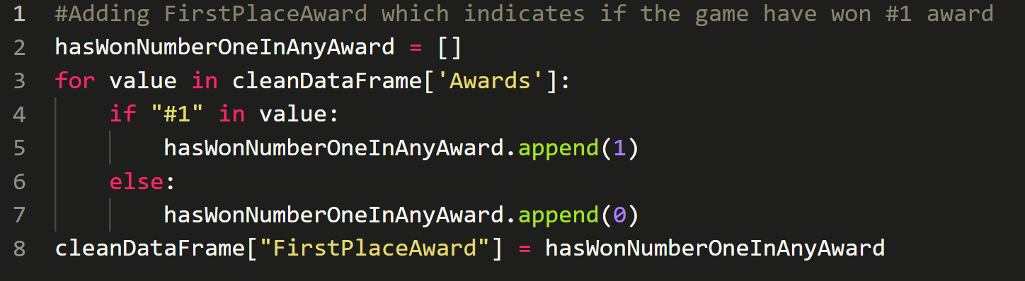
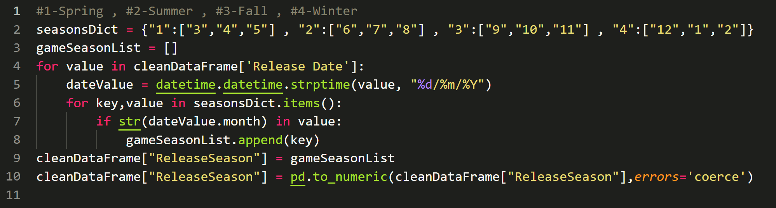
Handling Nessecry Missing Data
Filling missing values by column mean for numeric columns or by a predefined value for categorical columns.
Adding new categorial columns to help us with visualizing our data better and to help our machine learning process.
MainGenere column : representing the games main genre instead of a list of genres.
Creates a new column to indicate whether the game has won a first place award/ranking prize. In order to check later whether there is a relationship or influence on the quality of the review and the final score .
We created a new column : “ReleaseSeason”
which indicates the season of which the game was released ,
To see if there’s an impact of the release season on the score and reviews.

Slide 9
3|EDA

Slide 10
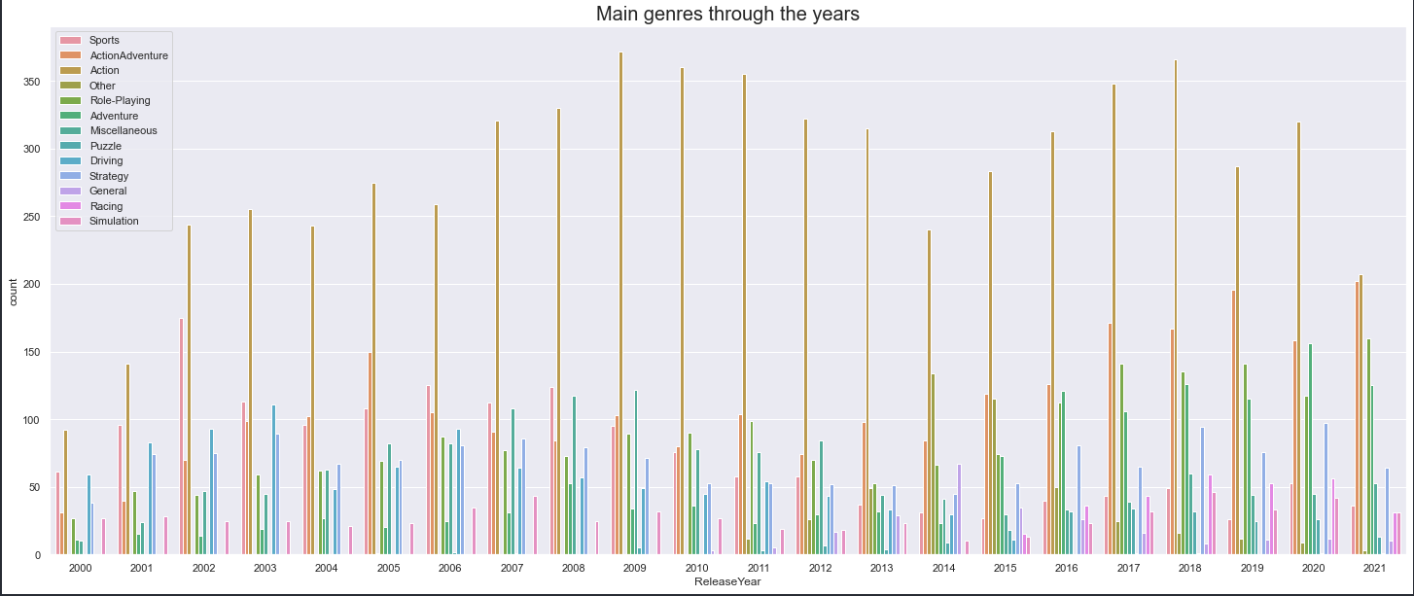
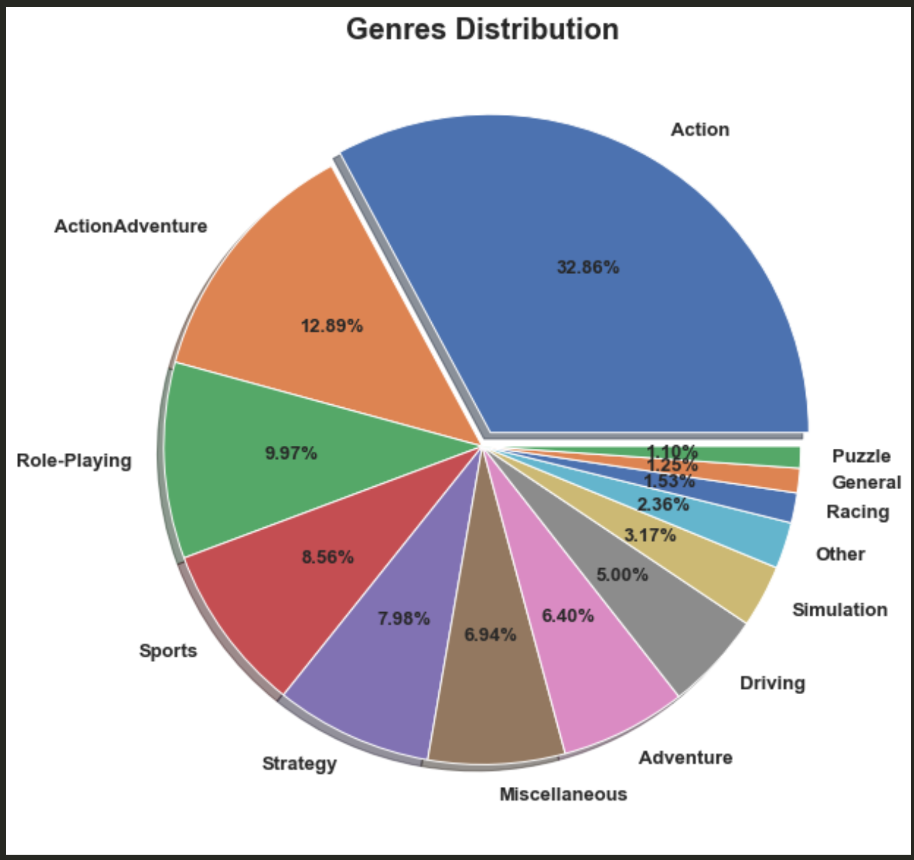
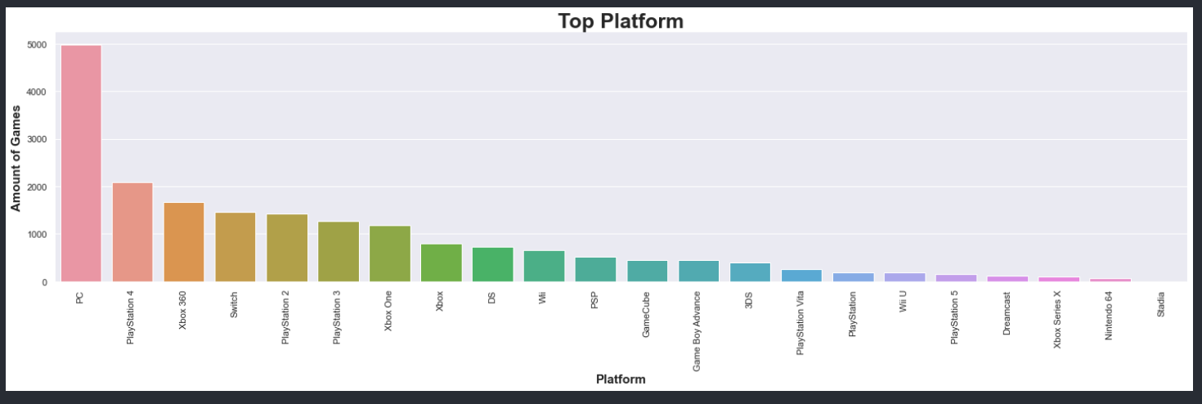
The following graphs shows that
The Action genre takes the major part of the games industry with ~33% and the most popular Platform
is the PC.
In addition, we can see that over the years Action Genre remains the Dominant Genre.

Slide 11
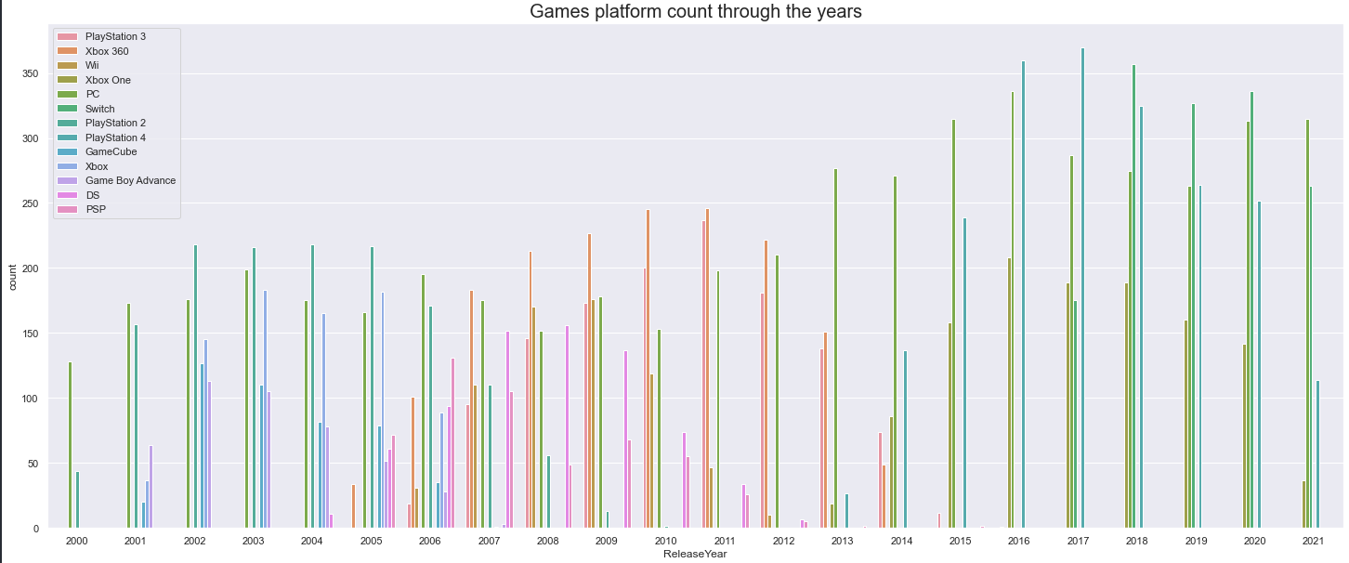
Top platforms over the years
In the last decade, the number of platforms has decreased, and four major platforms has taken over the platform market : PC , Xbox one , PlayStation, Switch.

Slide 12
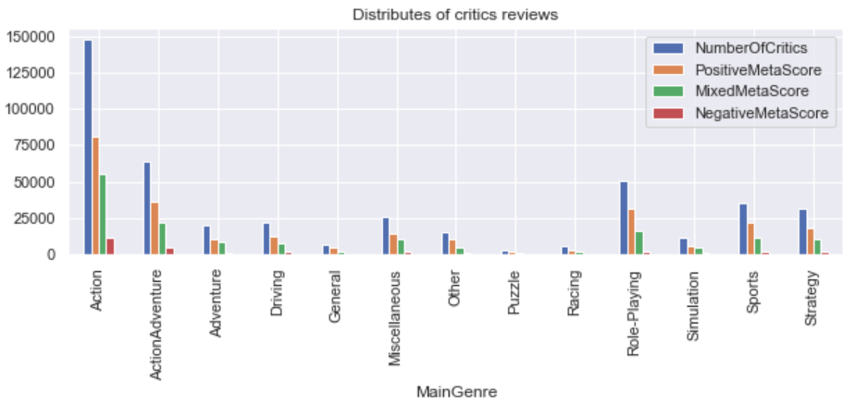
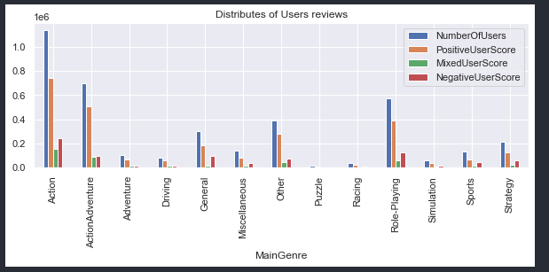
From this visualizations It can be seen that as the number of critics and users reviews increases, also the ratio between the positive reviews vs other kinds increased.
This shows us an existing relation between number of reviews to Positive reviews .
As a conclusion, it possible to assume that the Number of Critics and number of Positive reviews have positive influence on Meta Score.

Slide 13
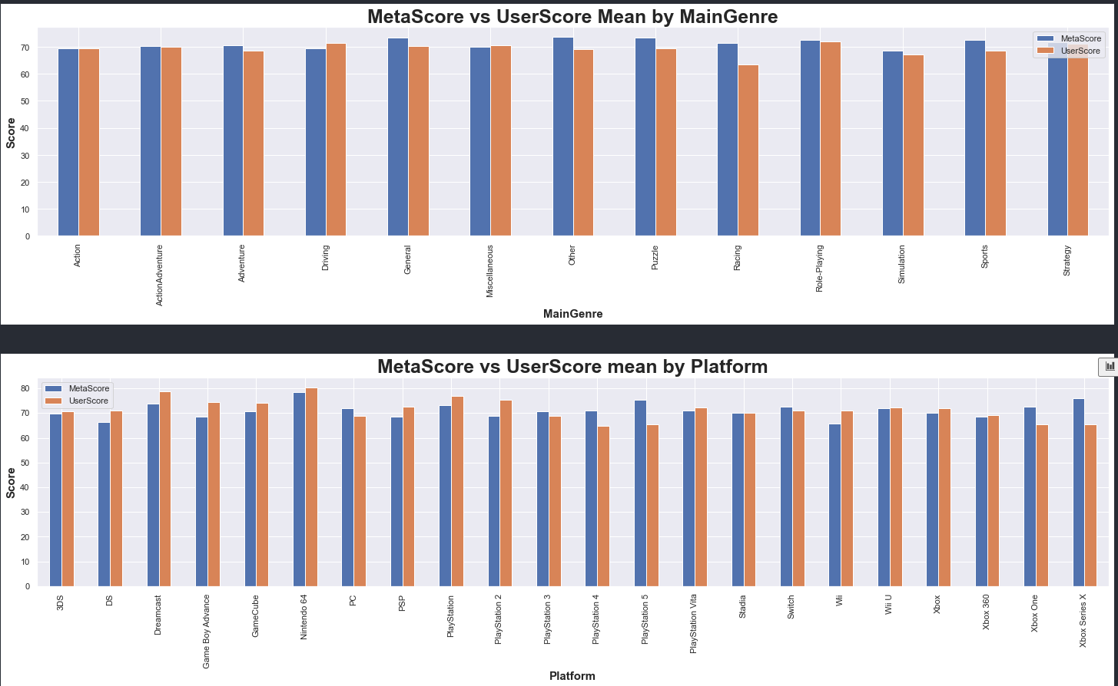
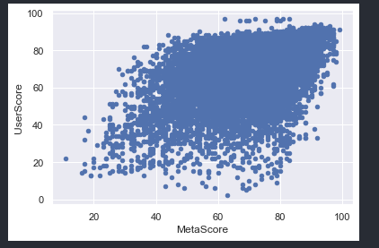
The following shows ratio between UserScore & Meta Score - almost the same with little deference.
This result means that there is relation between UserScore and MetaScore
Also, the scatter plot underneath, support the relationship mentioned above.

Slide 14
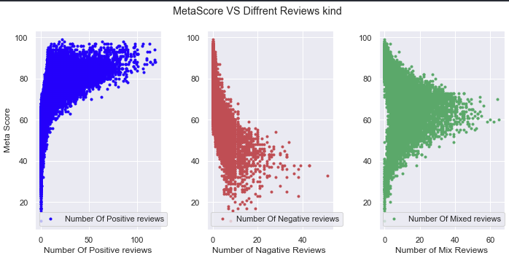
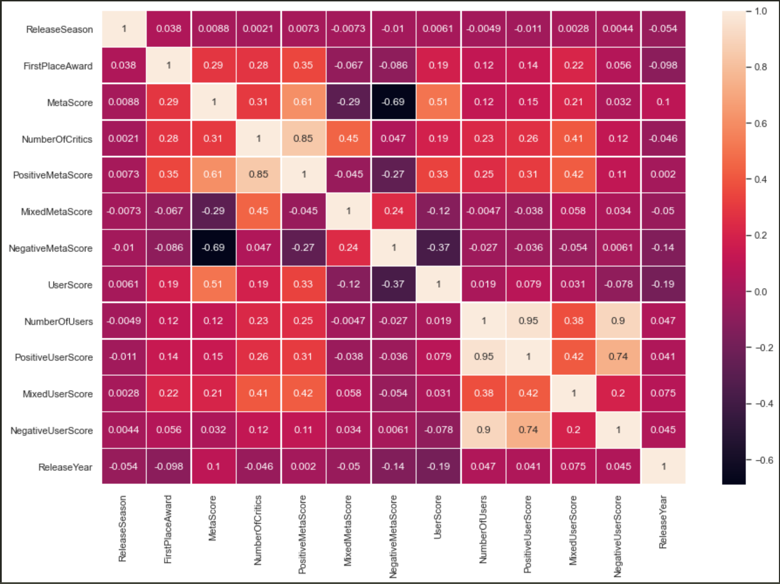
LET’S REVIEW SOME Conclusion
As we mention before, from EDA stage we found some
Interesting point:
There is relations between MetaScore & UserScore
There is relation between Number Of Critics & Positive Meta Score - This shows a trend which represent that people tend to review more if they have a positive opinion
There is relations between Meta Score & Positive Meta Score
Statistical evidence
The correlation heatmap arise a correlation between MetaScore & UserScore – 0.51
Correlation heatmap and the scatter plot arises also correlations between Number Of Critics & Positive Meta Score - 0.85
The correlation heatmap arise a correlation between Meta Score & Positive Meta Score - 0.61

Slide 15
4|Machine Learning

Slide 16
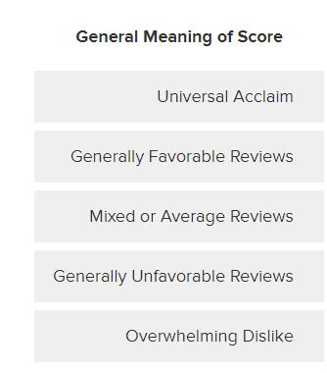
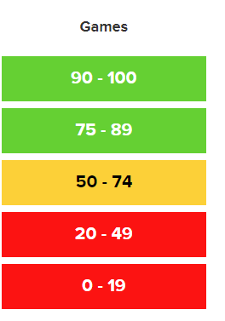
Model
Logistic Regression
Predection
Will the game Succeed?
Note
During learning stage we used a new column – “SuccessfulGame”. this column indicate whether the game is rated & reviews as Successful if his MetaScore is above or equal to 75. This assumption is based on information that was taken from https://www.metacritic.com/about-metascores.

Slide 17
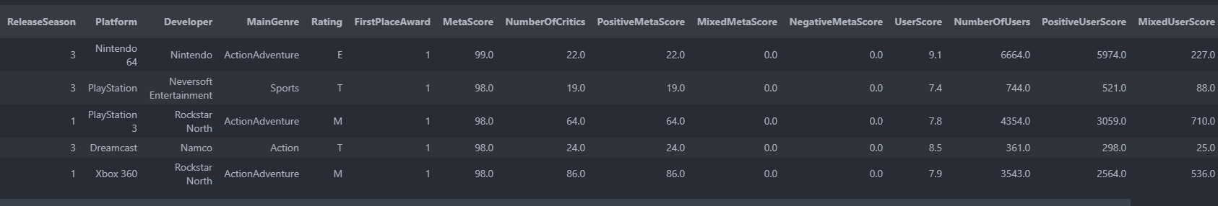
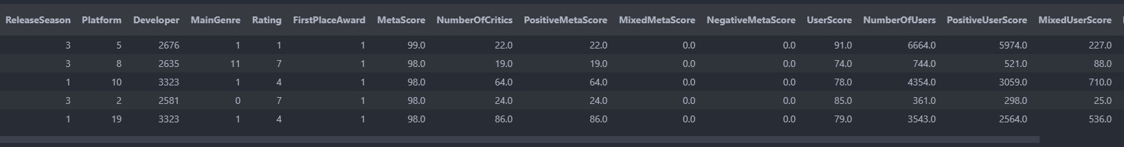
In order to make the predictions we drop unnecessary columns. And created new data frame for this stage. Then we made some manipulations and scaling such as: 1. Adding the predicted column. 2. scale UserScore column to same scale as MetaScore. 3. Encoded categorical columns into numeric. 4. used scaler on the Data Frame in order to bring all data to be in the same range 0-1

Slide 18
We used the fit method of a LogisticRegression model on the train data .
Message @Alzok
We split data frame into 2 part: (1) features. (2) predicted column
then split the data to train and test with the ratio of test size:20% , train size:80%.
We used the fit method of a LogisticRegression model on the train data. and lastly predicted the test data.
Results:
After applying the model on un-trained data and get the next Result

Slide 19
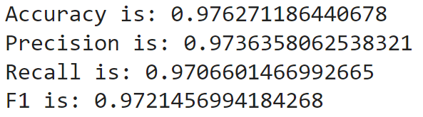
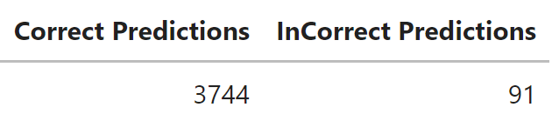
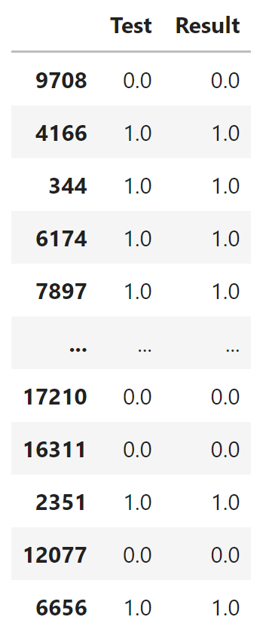
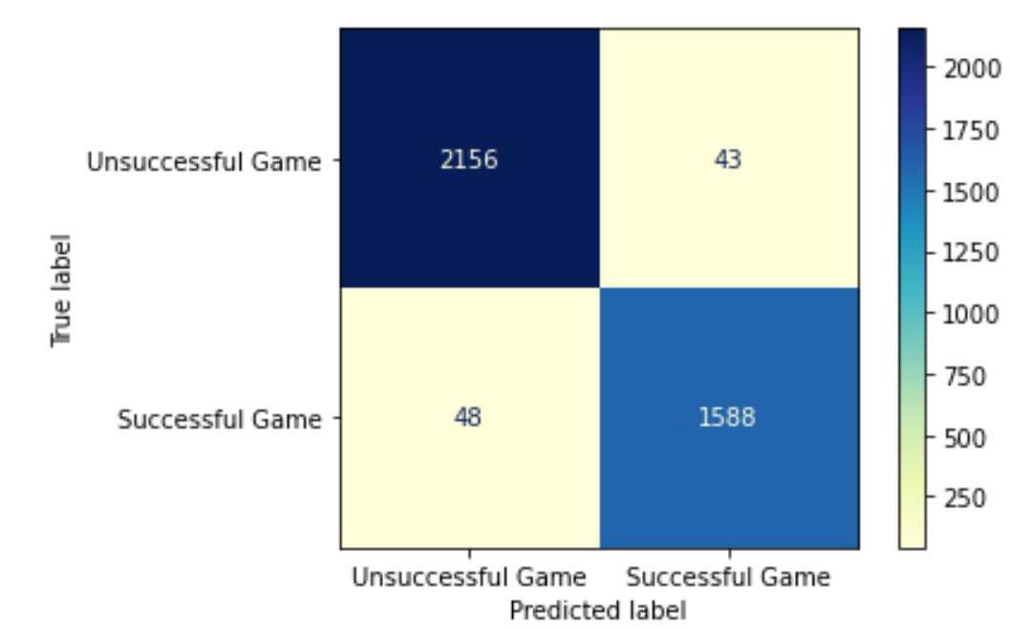
04|Machine Learning - Results

Slide 20
Conclusion
In our project we tried to answer, Is it possible to predict the success of the game according to specific characteristics?
In conclusion we have succeeded to predict the game success , but not by the attributes we thought would make the most contribution such as MainGenre or Platform.
Although we can conclude by our graphs other things like the most popular: Platform – PC , MainGenre – Action , Release Season – Fall , but it was not our initial question , and that people are more inclined to review and vote for a game if there have a positive opinion about it.

Slide 21
CREDITS.
Presentation Template: SlidesMania
Sample Images: Unsplash
Fonts used in this presentation: IBM Plex Mono

